Slide 1
RFID cut-resistant watch

Slide 2
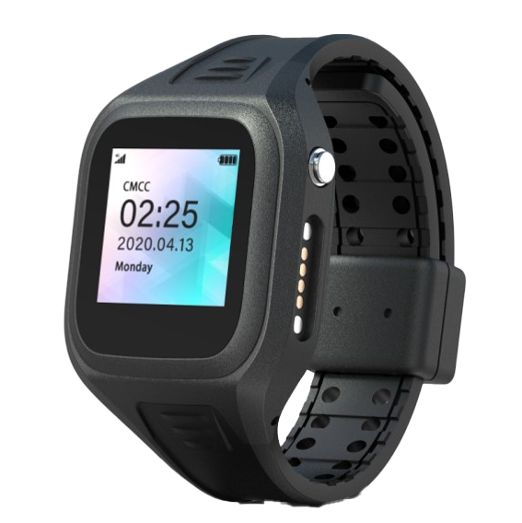
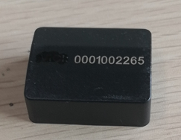
RFID Tag
Put the RFID tag inside the cut resistant watch
38mm*30mm*13.5mm
New RFID watch will not have screen and button

Slide 3
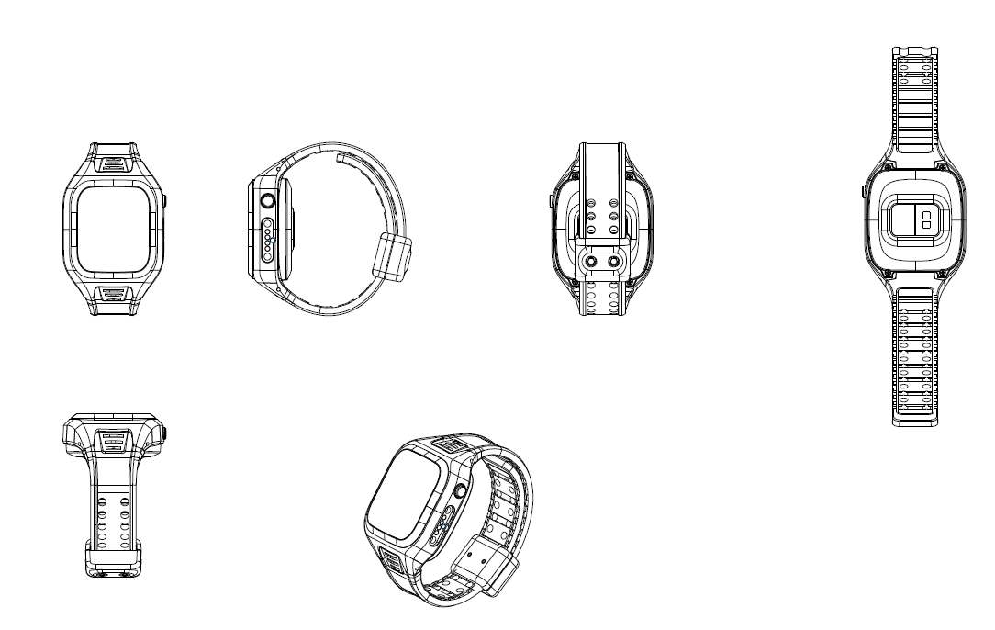
Watch design 1
Lock with special screw driver
Strap Not easy to cut

Slide 4
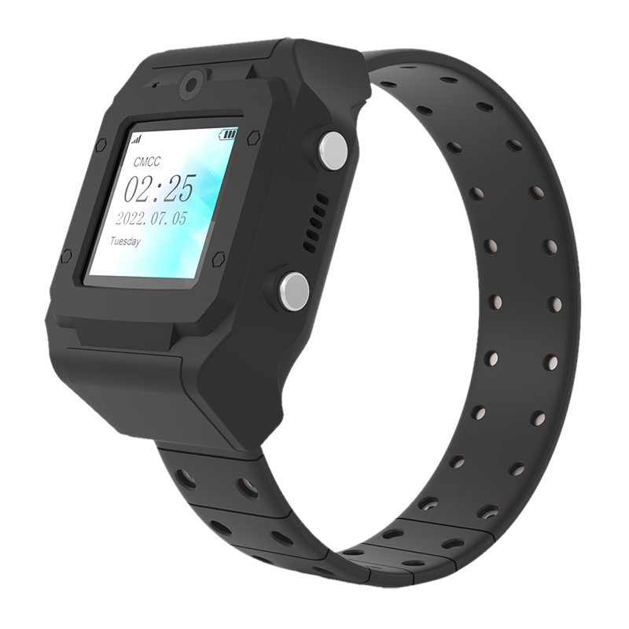
Another watch design
Strap has metal inside, difficult to cut, but the watch side is much bigger

Slide 5
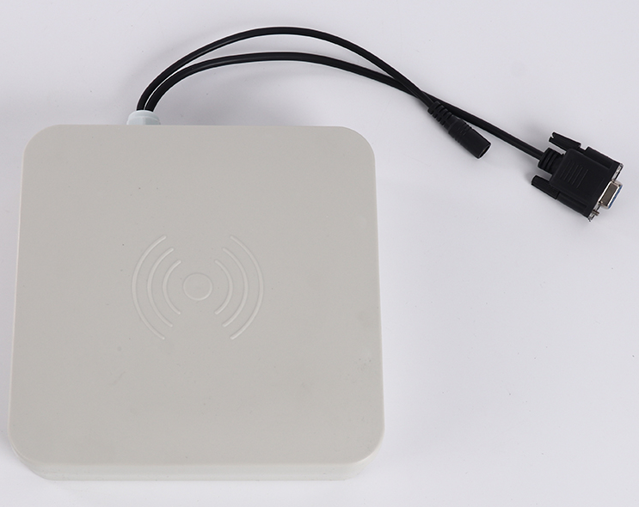
RFID Reader
Connect to network by WIFI or Lan. Scan the RFID and send multiple IDs to the server by TCP or UDP
Scan 2 meters RFID tag

Slide 6
Estimate Price
Product | Description | Unit price
 | Put the RFID tag inside the watch. | 50 USD
 | RFID reader, wifi or lan connection | 98 USD

